Slide 1
Jefferson SURP 2023
R for Beginners
😱
😎
Tess Cherlin, PhD
tess.cherlin@gmail.com
@alldayscientess

Slide 2
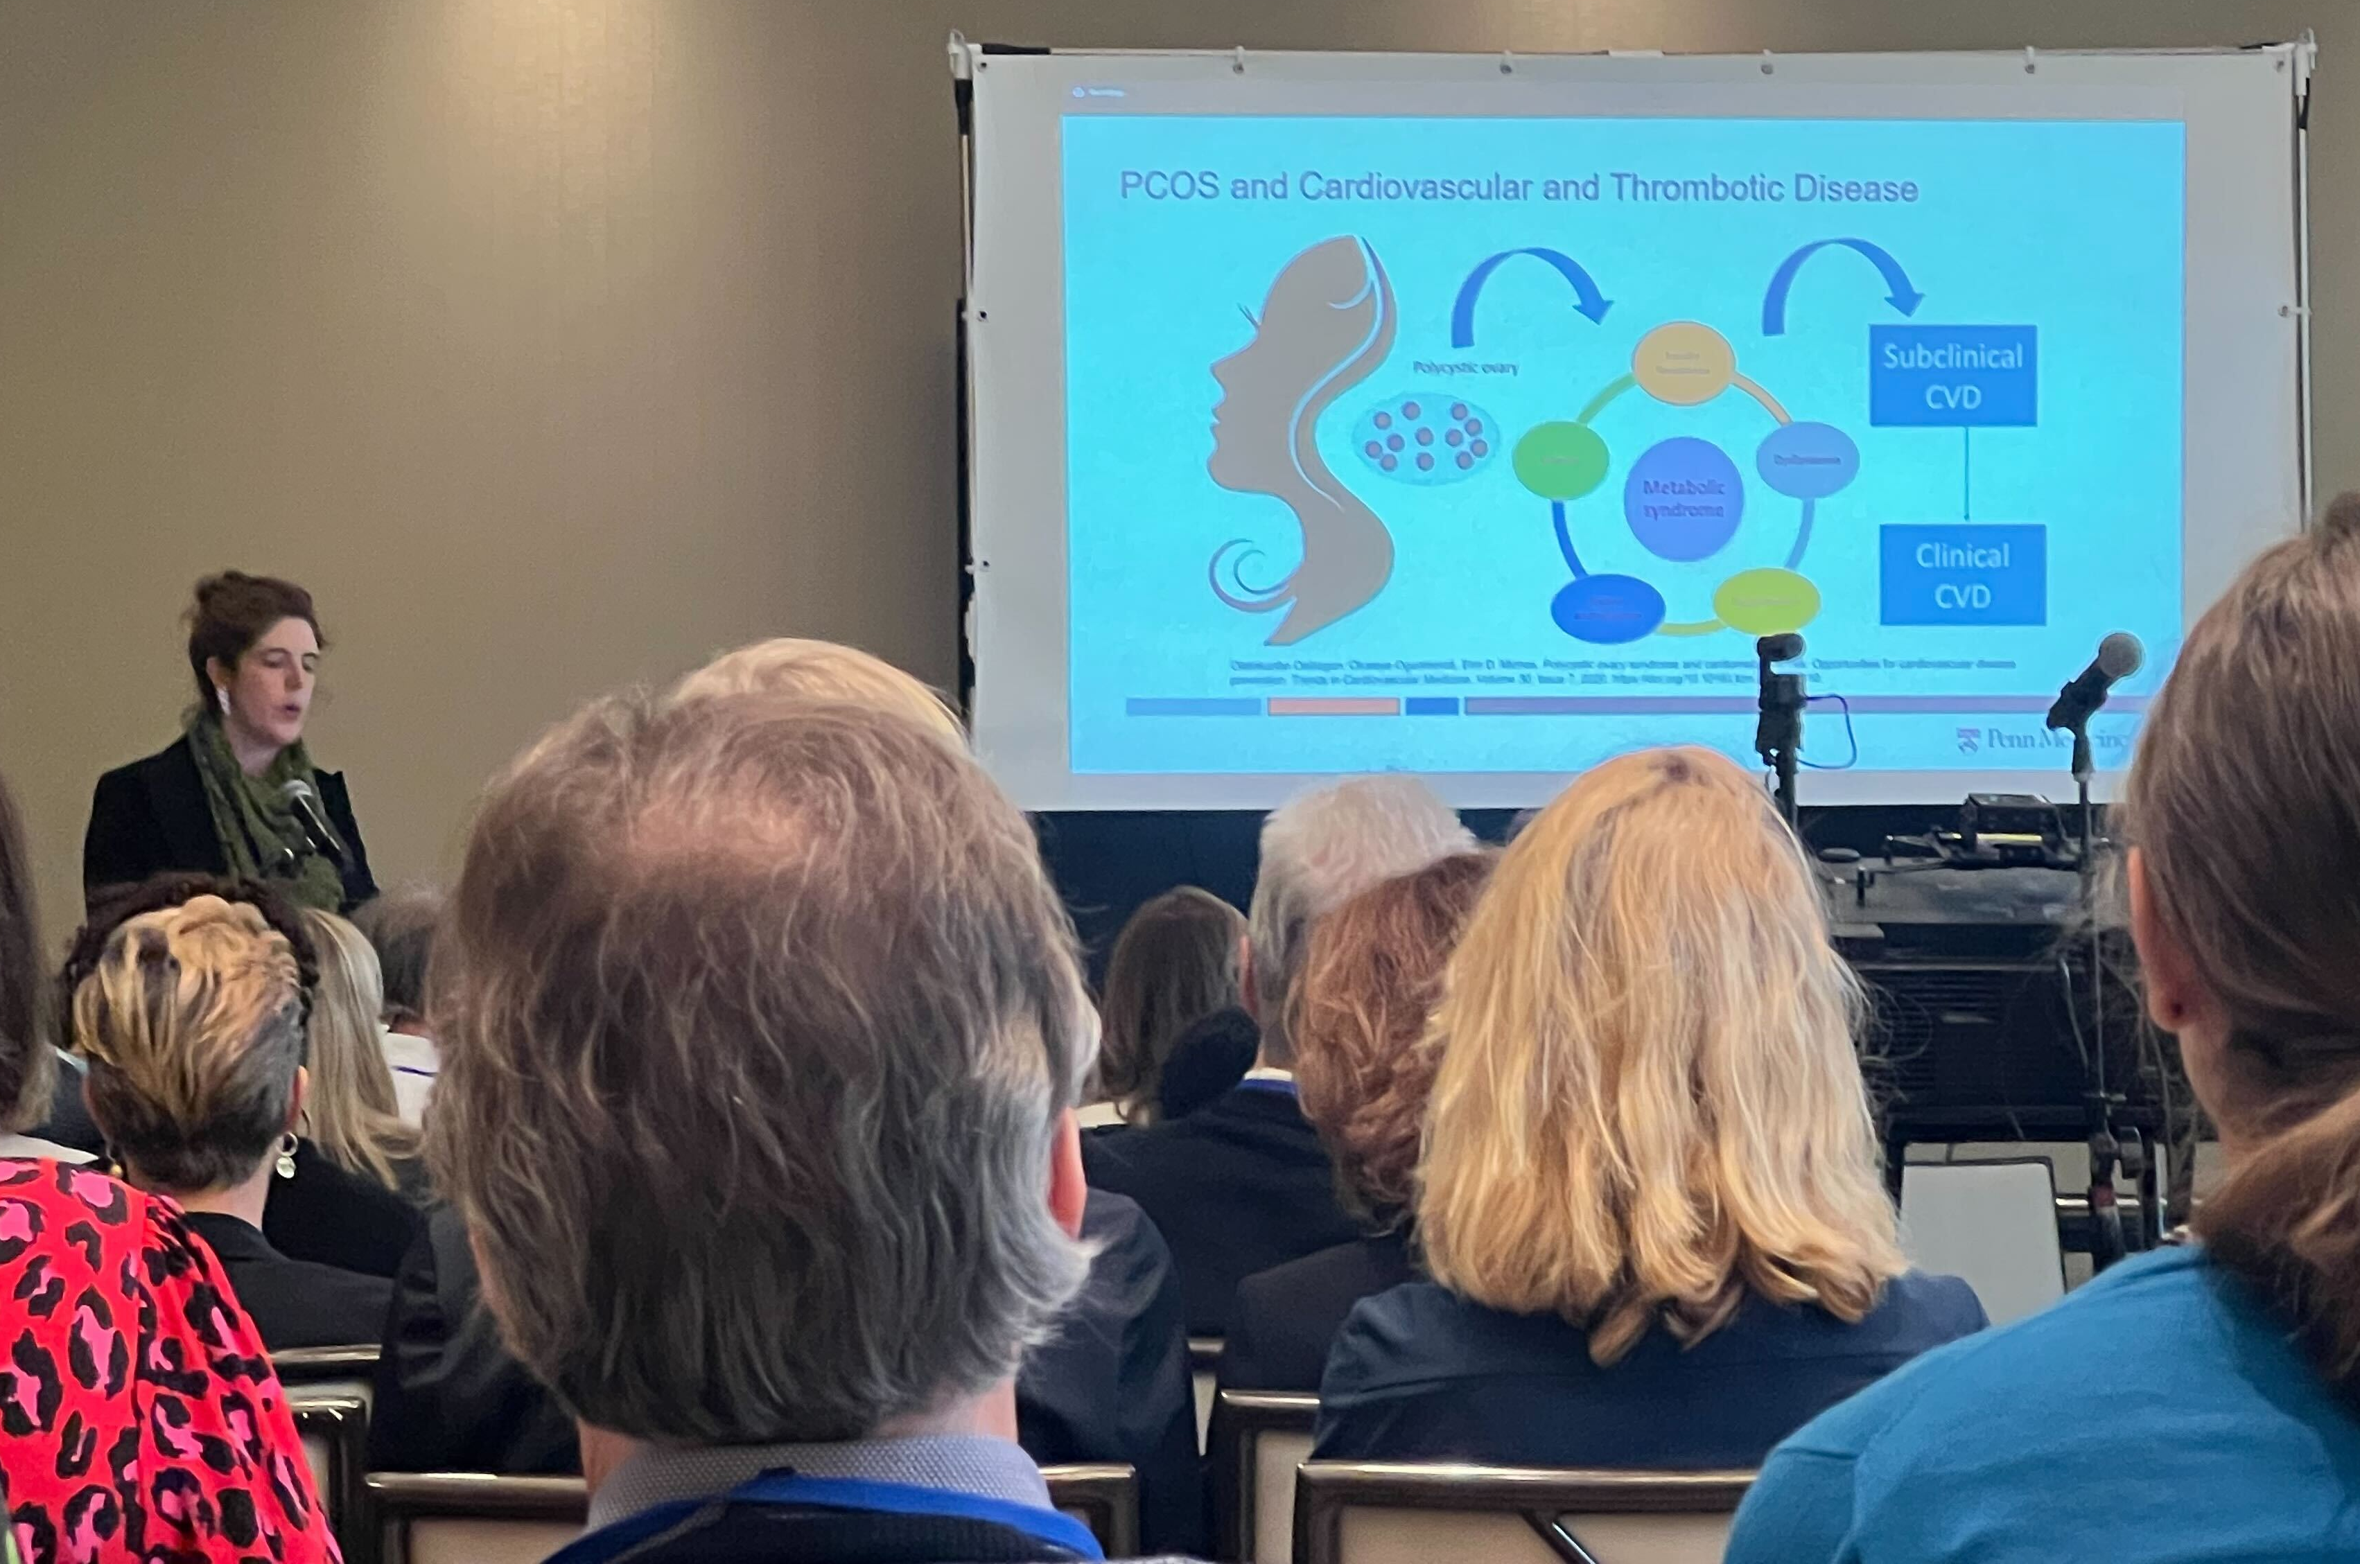

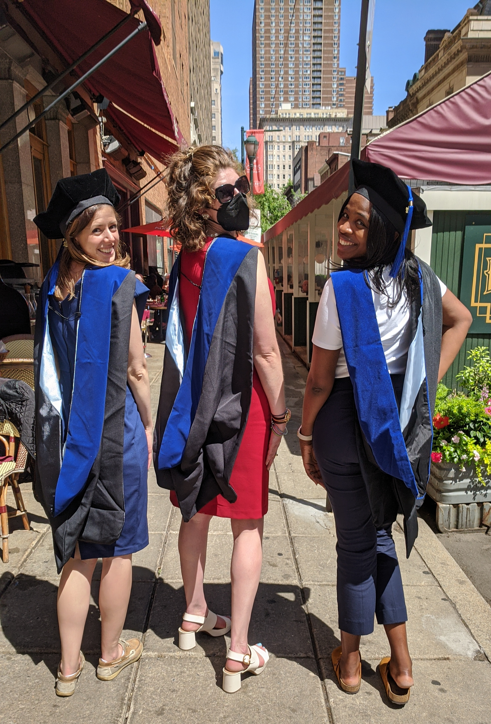
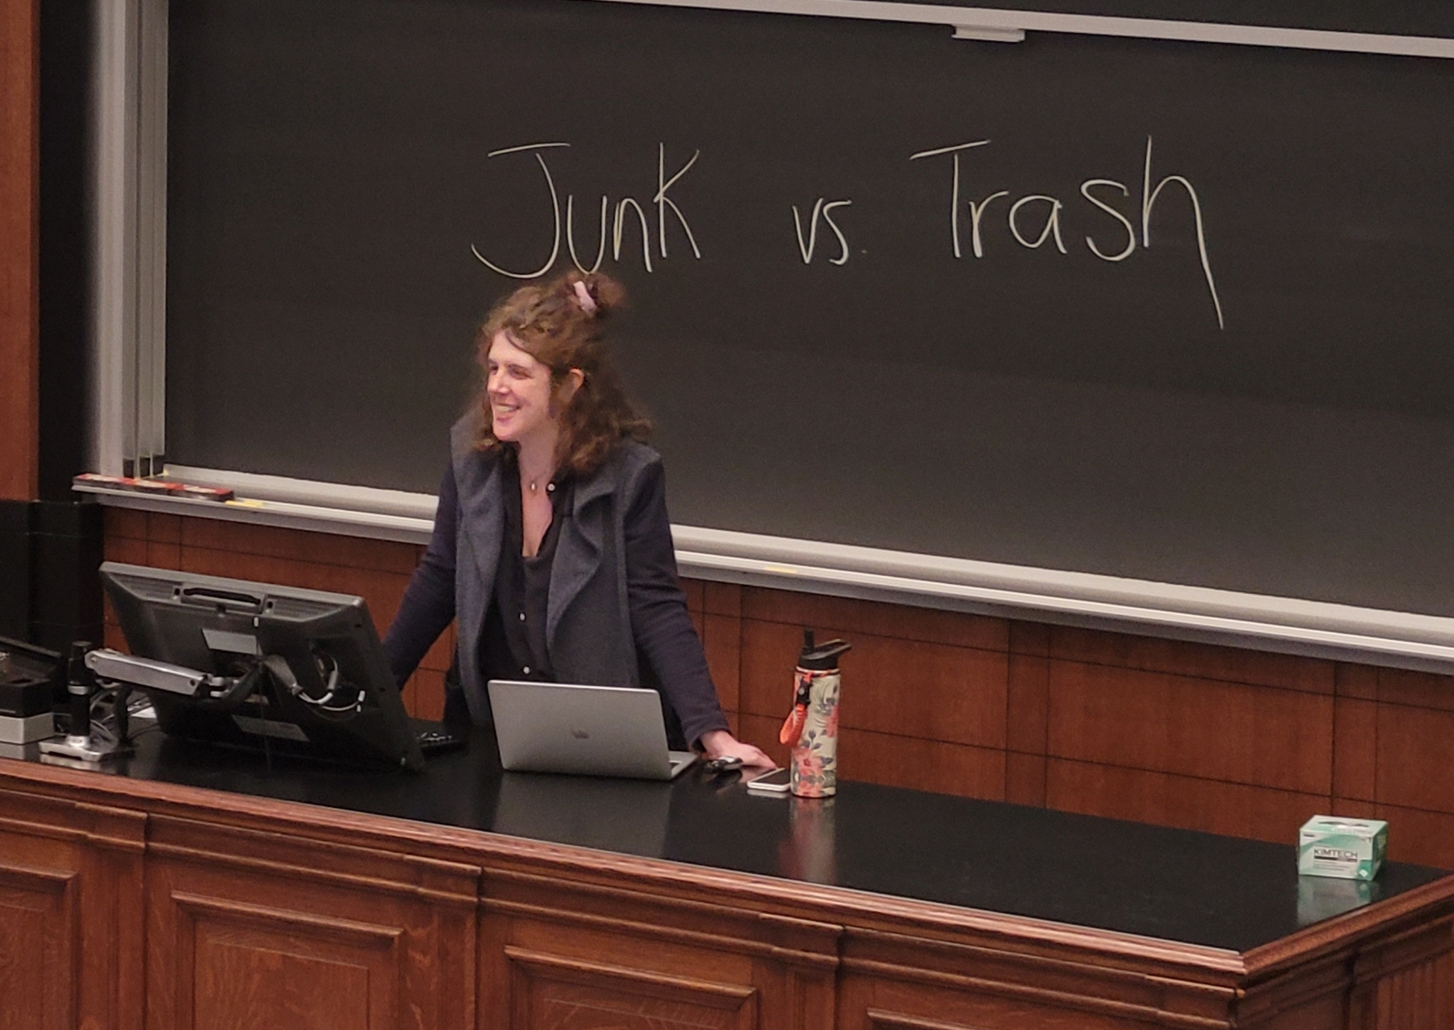

Introduction
PhD @ Jefferson
Genetics, Genomics, and Cancer Biology
Postdoc @ UPENN
Integrative Omics, PennPORT Fellow
Notes:
So, a little introduction about me, I’m a PhD student at Thomas Jefferson University in the Genetics, Genomics, and Cancer Biology where I use both wet lab research and computational research to study small molecules in our cells that contribute to cancer. And like our last speaker I had no coding background before I started in my lab in 2015. If I could learn this so can you!

Slide 3
R Workshop Overview
June 23: R For Beginners
July 14: More advanced and relevant data analysis and plotting
July 21: Make publication-ready figure (the goal)

Slide 4
Objectives
Goal
To become familiar and comfortable with the basics in R in order to pursue future learning and develop a greater appreciation of disparities in STEM careers, especially Computer Science
Provide a brief introduction to R, Rstudio, and Posit
Become familiar with the RStudio/Posit environment
Learn how to open R code and read in data files in Rstudio
Learn how to manipulate and write data in RStudio
Calculate basic statistics in RStudio
Create and and save barplots in RStudio

Slide 5



R, RStudio, and now Posit
RStudio is an integrated development environment for R
R is a language and environment for statistical computing and graphics.
RStudio but in the cloud!!!
Makes life much easier
Notes:
I’m not an expert

Slide 6
R for Beginners
This is going to be hands-on and hopefully fun!
It’s not going to be perfect or exhaustive (I don’t know everything!!!)
There are many ways to do everything – when in doubt GOOGLE “how do I ______ in R?” (or ChatGPT!!!)
Notes:
I’m not an expert

Slide 7


Women, Minorities, and Persons with Disabilities in Science and Engineering
2019 Report
A. Biological_or_Life_scientist
B. Computer_and_information_scientist
C. Mathematical_scientist
D. Physical_scientist
E. Psychologist
F. Social_scientist
G. Engineering_occupations
A. Hispanic_or_Latino
B. American_Indian_or_Alaska_Native
C. Asian
D. Black_or_African_American
E. Native_Hawaiian_or_Other_Pacific_Islander
F. White
G. More_than_one_race
B
C
F
G
A
D
E
D
C
F
A
B
E
G
Notes:
While you can use excel to plot the datasets we will be using today to show the gender and race/ethnicity in STEM Careers and Computer Science,

Slide 8
Step 1
Download the files from Github https://github.com/alldayscientess/SURP_R_Workshop_2023
Create Posit environment https://posit.cloud/
Upload files to Posit environment
Open R script
Notes:
I’m not an expert

Slide 9
Step 2 SURP_R_for_Beginners_Intro.R
Learn basic commands in R
Learn to assign values to variables
Discover types of data
Notes:
I’m not an expert

Slide 10
Different variables contain different types of data
Variable | Data Type
Integer (Int) / Numeric | 1, 2, 3, 4, 5
Character (char) | A, a, B, b, 1, 2, 3
String | ”You’re 2 cool!”
Floating point number (float) | 2.53, 1000.2354
Boolean | TRUE or FALSE / 1 or 0
*See reference

Slide 11
R is a weakly typed language
A variable can be reassigned a value in R
myVariable = 10
myVariable equals 10
myVariable = “Panda”
Now myVariable = “Panda”
*See reference
Notes:
Ask students what variable type 10 and “Panda” are

Slide 12
Data Types - Vectors
Vectors are a group of data values
1 2 3 4 5
”Dog” ”Cat” “ Mouse” “Snorlax” “Bigbird”
*See reference

Slide 13
Data Types - Matrices
Matrix is a two dimensional vector
1 2 3 4 5
1 3 2 5 6
7 4 6 3 2
Vector
Matrix
Matrices hold only one data type at a time
*See reference
Notes:
At this point we can ask some what are some examples of data types

Slide 14
Data Types – Data Frames (Advanced Matrices)
“Name” | “Age” | “# of Donuts”
“Tess” | 30 | 6
“RLadies” | 25 | 5
Individual columns of a data frame can be called for by name
Can contain different data types
*See reference
Notes:
Rogan starts talking about different data types with students. Rogan will teach students to work with variables.

Slide 15
myData=[1:10]
mean(myData)
DATA
[1:10]
Variables
Store Data
Functions
Manipulate Data
*See reference

Slide 16
Step 3 SURP_R_for_Beginners_DataAnalysis.R
Learn to read in csv files to RStudio environment and assign to variable
Analyze data in RStudio
Calculate statistics on data in RStudio
Write files from RStudio to Desktop
Notes:
I’m not an expert

Slide 17
Step 4 SURP_R_for_Beginners_Barplots.R
Learn useful R functions
Create barplots() in RStudio
Learn how to add legends to plots in R
Create first R Script
Notes:
I’m not an expert

Slide 18
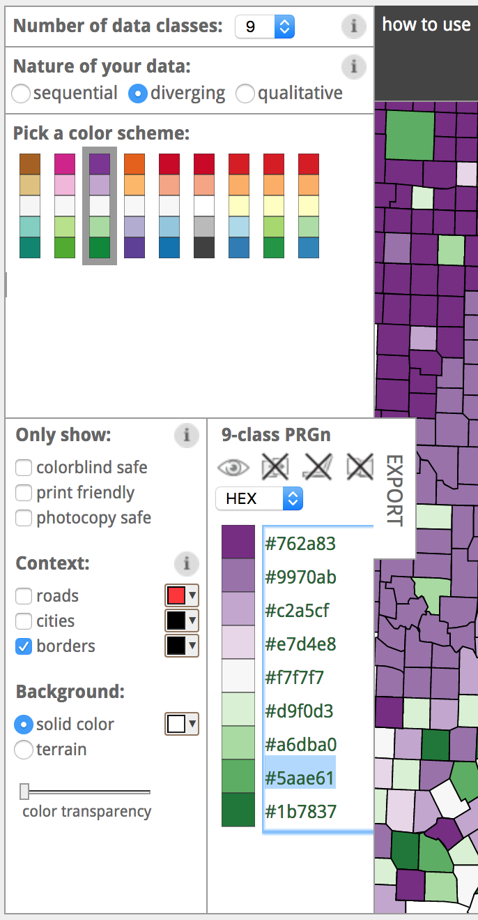
https://colorbrewer2.org/

Slide 19
https://colorbrewer2.org/

Slide 20
Homework
Due July 14
Finish Making your first R Script
What do you do if you have problems?
Think about 2-3 deliverables you would like to make with R

Slide 21
References
Datasets were taken from the Women, Minorities, and Persons with Disabilities in Science and Engineering Report https://ncses.nsf.gov/pubs/nsf19304/data
Some of the slides (*) were taken from a previous R Bootcamp Workshop I did with Rogan Magee in 2017

Slide 22
Thank you!!!
Tess Cherlin, PhD
tess.cherlin@gmail.com
@alldayscientess

